Slide 2
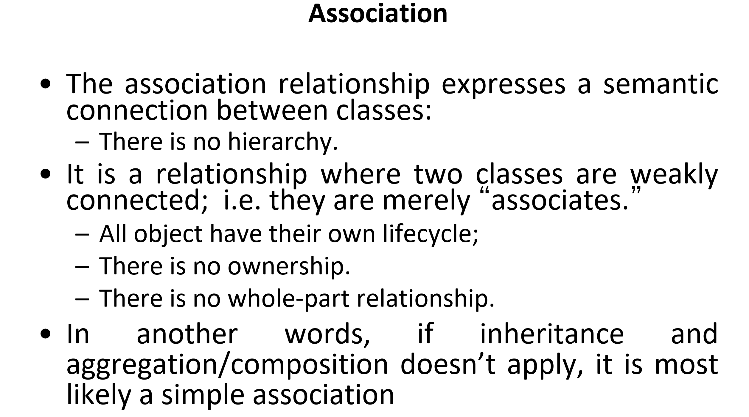
Notes:
An association relationship in OOP is a connection between two or more classes where the objects of these classes can interact with one another. Unlike other relationships like inheritance or composition, association does not imply any hierarchical structure or ownership between the involved objects.
No Hierarchy:
In association, the two classes involved are treated as peers. This means one class does not derive from or inherit the other. There’s no "is-a" relationship here like in inheritance (where one class is a specialized version of another).
Weak Connection:
Association describes a relationship where the two classes are loosely coupled. The phrase "weakly connected" emphasizes that the objects of one class are aware of objects from another class, but they are not tightly bound. This means changes to one class don't necessarily affect the other class directly.
They are "associates," meaning that while they can work together, they operate independently.
Objects Have Their Own Lifecycle:
Each object in the association maintains its own lifecycle. If one object is destroyed or goes out of scope, it does not necessarily affect the existence of the other object.
For example, a "Student" class and a "Course" class can have an association. A student may enroll in a course, but if the course is canceled, the student still exists independently, and vice versa.
No Ownership:
Neither class owns the other. In some relationships like composition, one class can "own" another (e.g., a class "Car" owns a class "Engine"). But in association, both classes are independent. This means no one class controls the lifecycle or actions of the other.
No Whole-Part Relationship:
In composition, there's typically a whole-part relationship where one class is made up of the other class. For example, a "Library" class may be composed of "Books," where the library owns the books.
However, in association, there is no such whole-part relationship. The classes involved are just loosely related for a specific purpose without being a part of one another.
When is it an Association?
No inheritance or composition/aggregation:
If a relationship between classes doesn’t involve inheritance (where one class is derived from another) or composition/aggregation (where one class is made up of other objects or parts), it is most likely an association.
In other words, association is often the default relationship when more structured relationships like inheritance or composition do not fit.

Slide 3
Types of Association
One-to-One
One-to-Many
Many-to-Many
Notes:
A person has only one passport, and a passport is associated with only one person.
A teacher can teach many students, but a student usually has one main teacher.
Students and courses have a many-to-many association, where a student can enroll in multiple courses, and a course can have many students.

